Slide 1
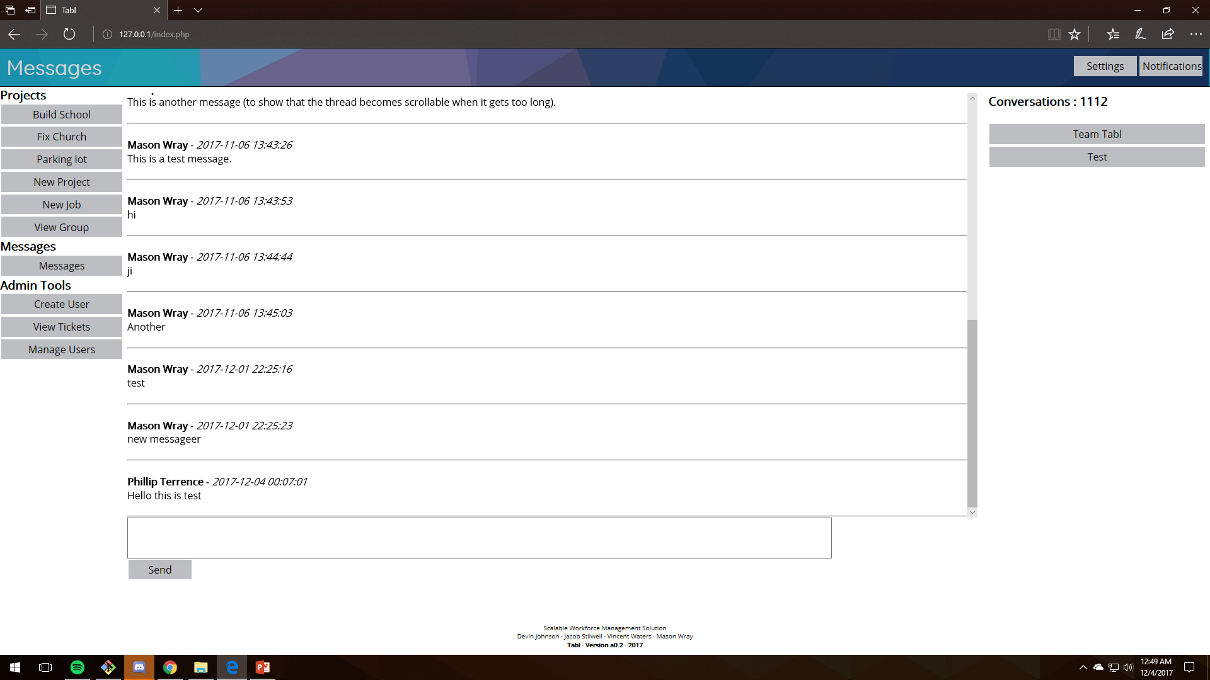
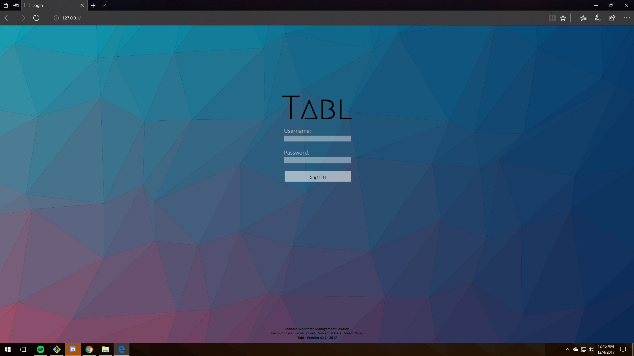
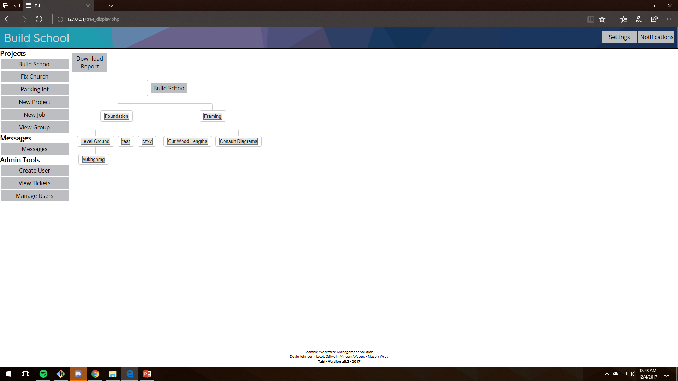
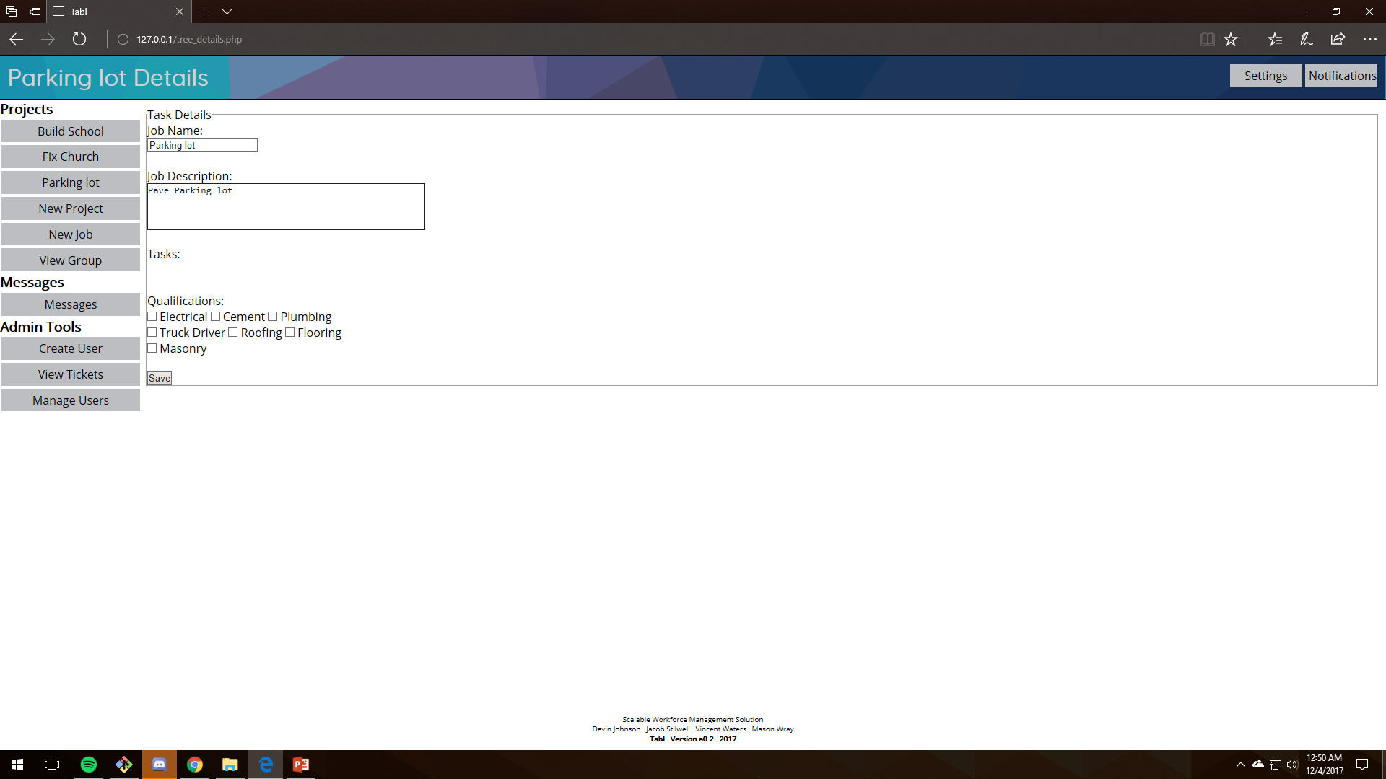
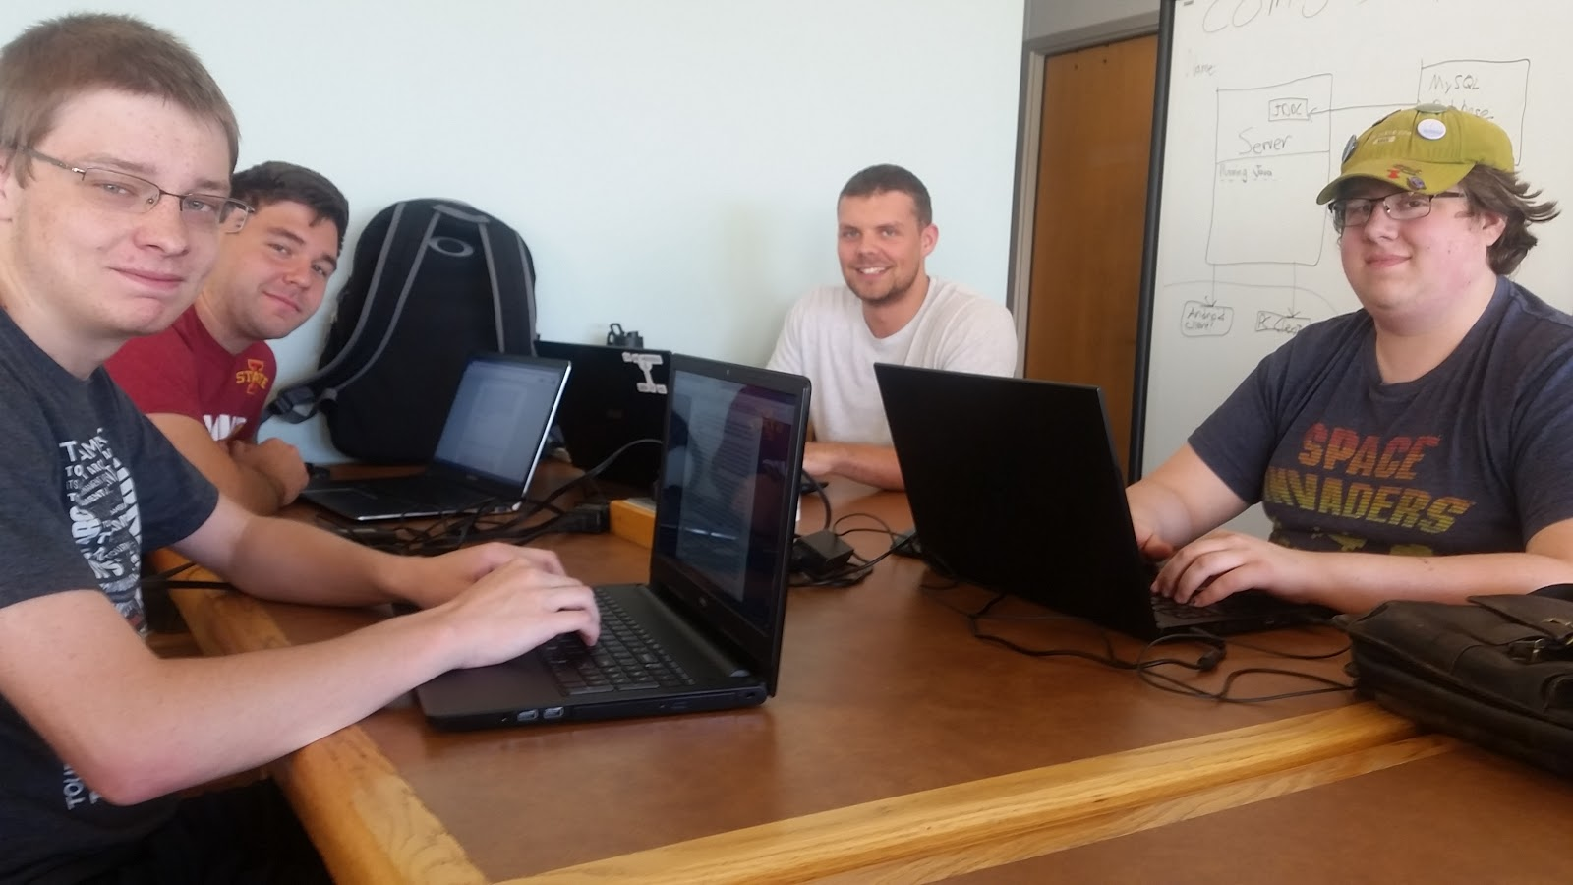
Project TABL
Devin Johnson – Jacob Stilwell – Vincent Waters – Mason Wray
CS 309 – Fall 2017
Project Description
User Interfaces
Block Diagram
Design Decisions
Teamwork

